Slide 1
BUS TOUR
Andes Herviana 1301154523
Damaiyanto Hadomuan 1301150061
Muhammad Farhan 1301154117
Yolanda Modesty 1301154453

Slide 2
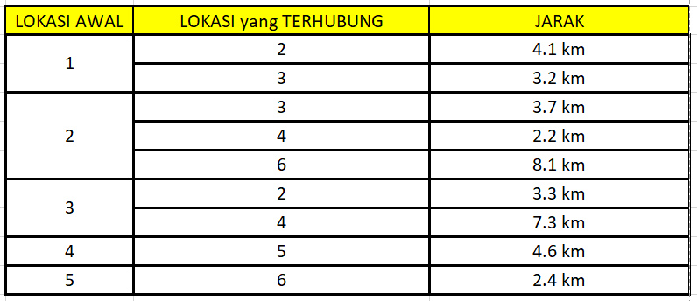
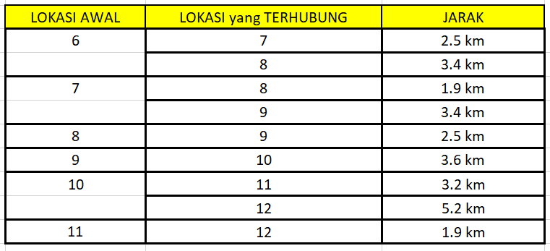
DATA JARAK ANTAR TEMPAT WISATA, HOTEL, MARKAS BUS

Slide 3
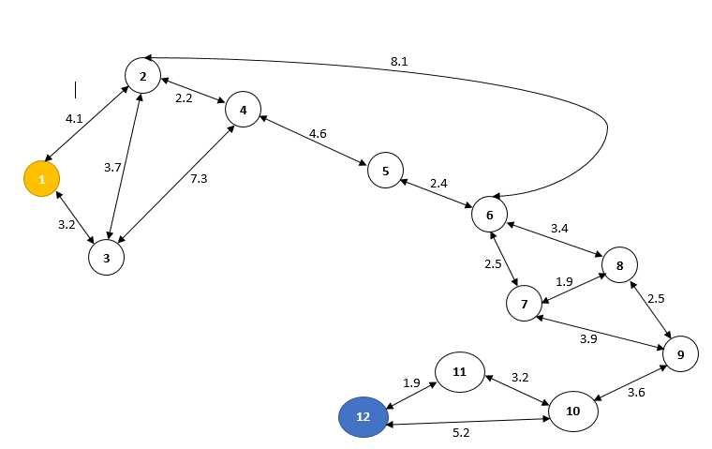
PETA TAMASYA in WARSAW

Slide 4
KETERANGAN LOKASI
1. City-Sightseeing Warsaw Centre
2. Plac Pilsudskiego
3. Nowy Swiat Chopina
4. Plac Bankowy
5. Zamec Krolewski
6. Kralewski Prezeomiescie
7. Universytet Warzaw
8. Nowy Swiat Narodowe
9. Kompleks Palacony
10.Centrum Palac
11. Nowy Zamec
12. Royal Castle
MARKAS
HOTEL
Tempat Wisata

Slide 5
METODE BRUTEFORCE
1-2-3-4-5-6-7-8-9-10-11-12 : 37.7 km
1-3-2-4-5-6-8-7-9-10-11-12 : 34.0 km
1-2-4-3-2-4-5-6-7-9-8-7-9-10-11-12 : 49.9 km
1-2-6-5-4-2-3-4-5-6-8-7-9-10-11-12 : 57.3 km
1-3-4-2-6-5-6-7-8-9-10-11-12 : 41.2 km
1-3-4-2-6-5-6-8-7-9-10-11-12 : 43.5 km
1-3-4-2-6-5-6-7-9-8-7-9-10-11-12 : 49.0 km
1-3-4-2-6-5-6-7-9-7-8-9-10-11-12 : 49.0 km
1-3-4-2-6-5-6-7-6-8-9-10-11-12 : 45.2 km
1-3-4-2-6-5-6-7-6-8-7-9-10-11-12 : 48.5 km

Slide 6
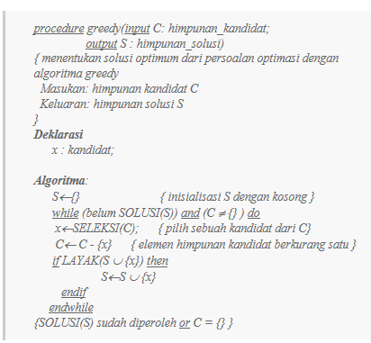
Dengan greedy

Slide 7

HASIL CODE in matlab
Jika kecepatan rata2 bis mengendarai 30km/jam
Maka :
Kecepatan rata2 dengan metode greedy
= (60/30) * 31 = 62 menit perjalanan 1 arah

